Slide 1
Week 4 – Hands-on tutorial
Regression Modelling using RapidMiner

Slide 2
Introduction – RapidMiner ‘Design’
RapidMiner Design contains four major panels by default, including Repository, Operators, Process and Parameters.
Repository panel includes datasets to be fed for analysis.
Operators panel contains more than 500 operators altogether for various tasks of professional data analysis.
Process panel displays the designed data analysing processes to be created and managed.
Parameters panel allows users to set parameters for the selected processes.

Slide 3
Introduction – RapidMiner ‘Design’
This week, we will use the RapidMiner Design to conduct Regression modelling analysis.
The concept and understating of regression model is needed for designing the regression processes in this week.

Slide 4
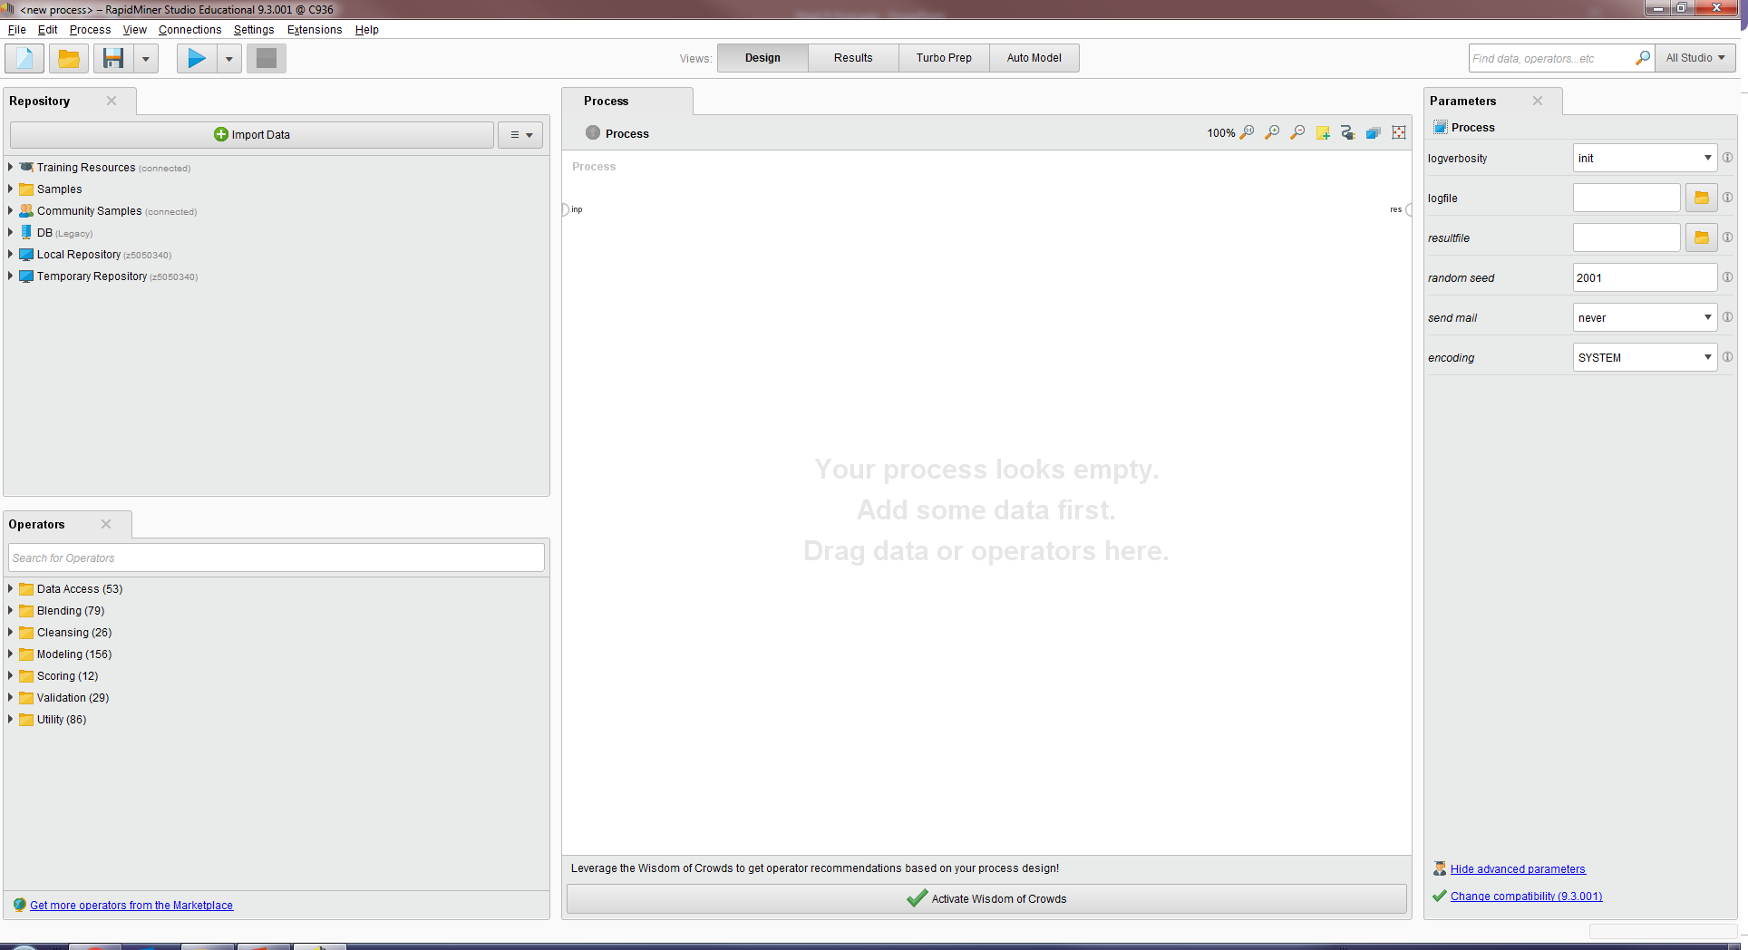
Introduction – RapidMiner ‘Design’
RapidMiner Design

Slide 5
Data pre-processing

Slide 6
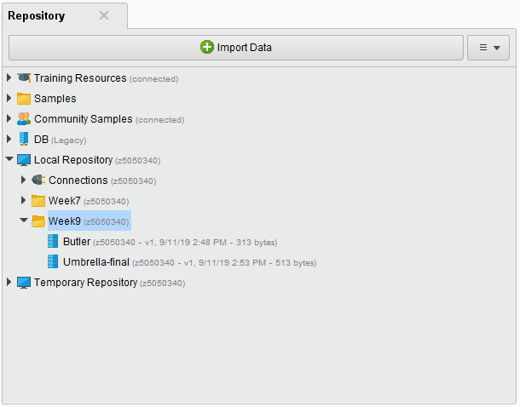
Add dataset to Repositories
‘Butler’ dataset is used for this presentation:
Download the ‘Butler’ dataset from Moodle website.
Import it into the Repositories.
Import data

Slide 7
Set Label for dataset
To apply Regression, one attribute of the dataset needs to be specified as the role of the dependent variable. Two methods can be adopted in RapidMiner Design for this task.
Method 1 – Editing dataset:
  Right click on dataset and choose Edit,
  Right click on the attribute to be set as dependent variable and choose Modify Attribute,
  Choose Label as the role of the selected attribute,
  Save the dataset.

Slide 8
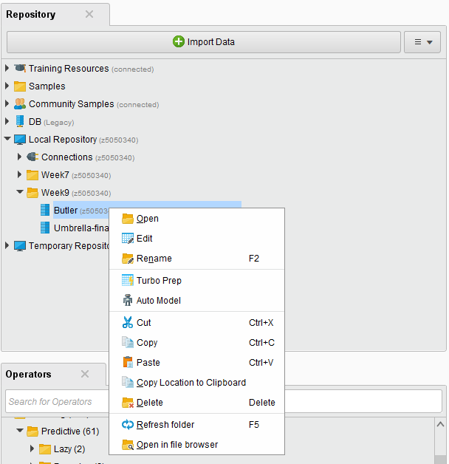
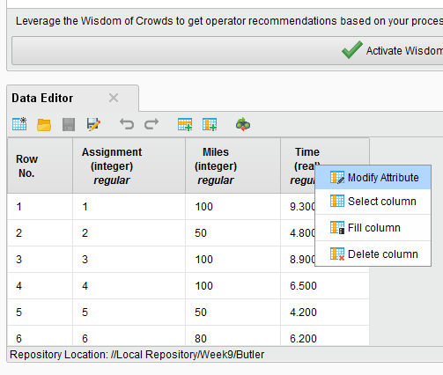
Method 1 – Editing dataset
1. Right click on dataset and then choose edit
2. Right click on one attribute and then choose Modify Attribute.

Slide 9
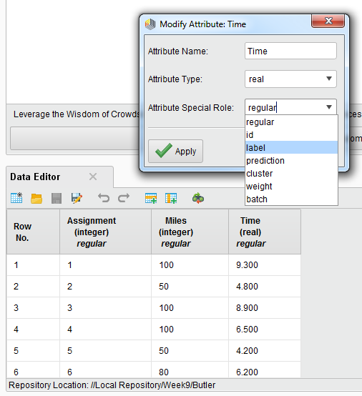
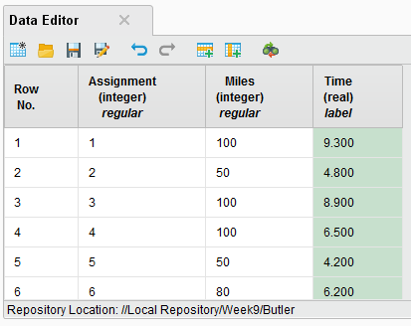
Method 1 – Editing dataset
3. Select Label as the role of this attribute, which means this attribute will be recognized as the dependent variable.
4. Save the change in the dataset.
Note: Using this method will permanently Label the selected attribute in this dataset until it was changed back.

Slide 10
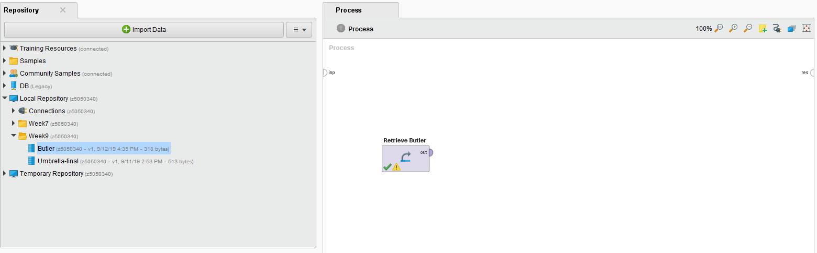
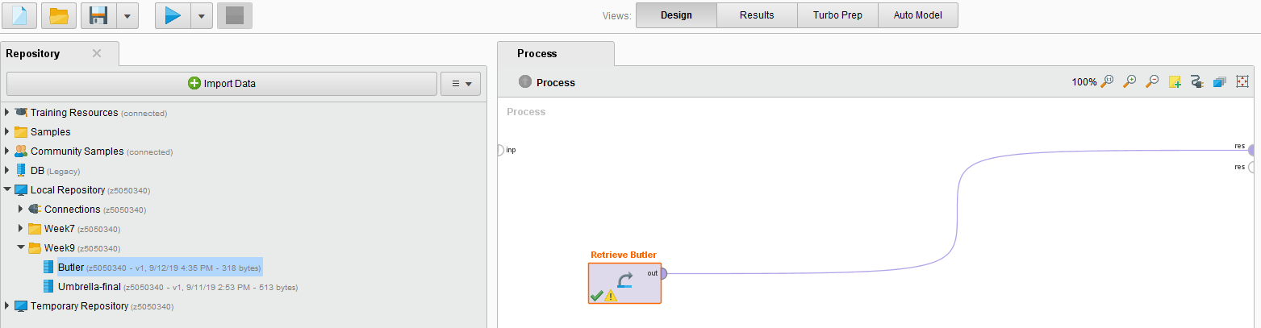
Method 1 – Editing dataset
After saving the dataset, simply drag the dataset into the Process panel
The dataset will appear in the Process panel, then drag a cable from the ‘out’ of the dataset, to the ‘res’ of the panel.
This cable means that the output of this module is the result of the designed data process.
Lastly, click on the ‘Run’.

Slide 11
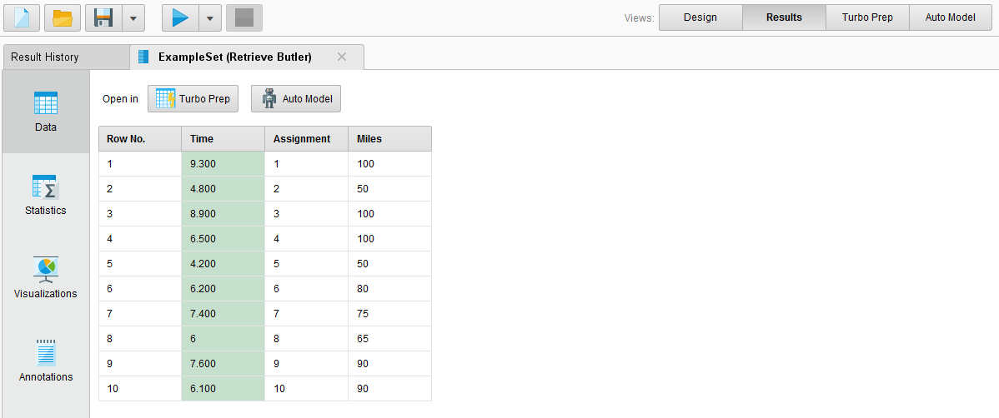
Method 1 – Editing dataset
The software automatically turns to the Results interface.
The ‘Time’ attribute is highlighted, which means it has been Labelled.

Slide 12
Method 2 – Set Role
Another method to set one attribute of a dataset as Label is to use the Set Role operator.
Method 2 – Set Role:
  Drag the dataset to the Process panel,
  Type ‘set role’ in the Operators panel to find the particular operator,
  Drag the ‘Set Role’ operator into the Process panel,
  Connect ‘Butler’ to ‘Set Role’ by dragging a cable, then output ‘exa’ to the ‘res’ of the Process panel.
  Click on the ‘Set Role’, and in the Parameters panel, choose ‘Time’ and set role as ‘label’.

Slide 13
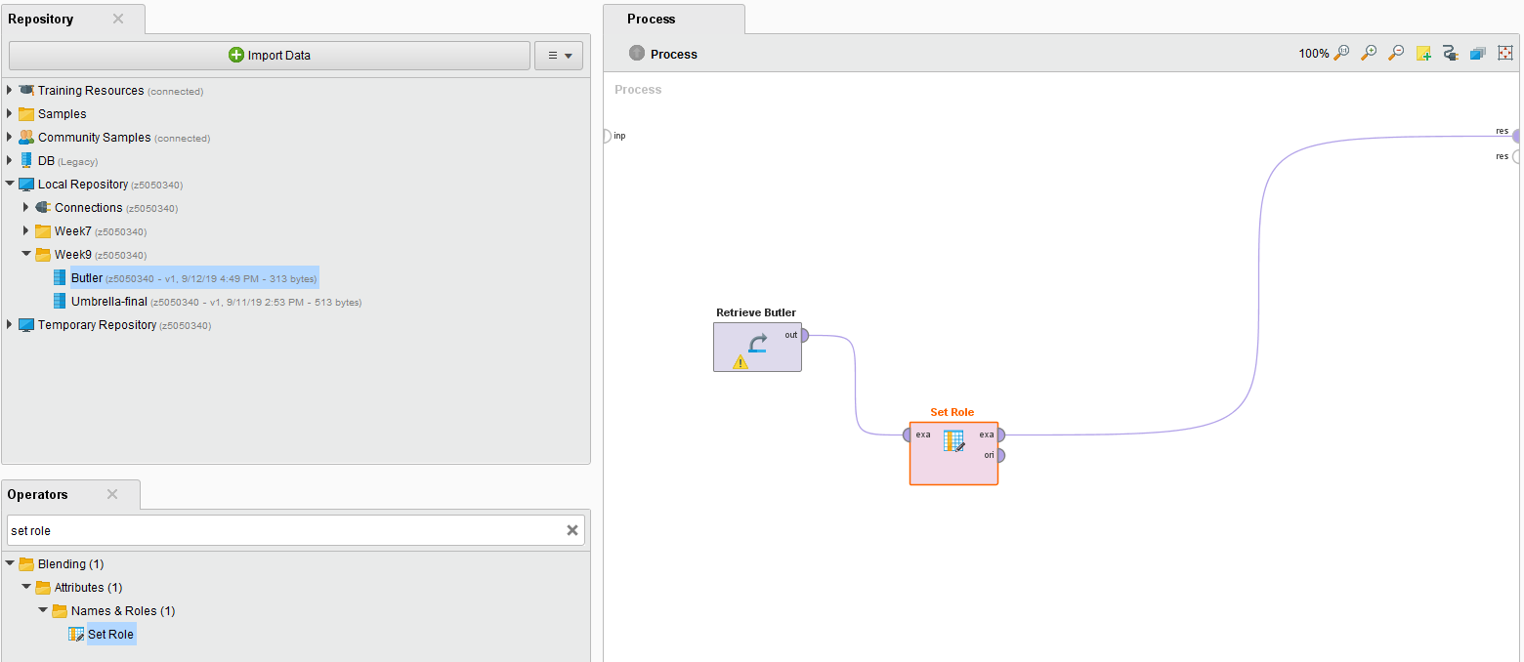
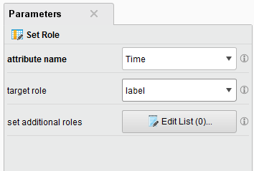
Method 2 – Set Role
4. Connect
The software automatically turns to the Results interface.
1. Drag
2. Type
3. Drag
Note: This method will not modify the dataset itself.
5. Click ‘Set Role’ and set the ‘Time’ as ‘label’.
You will see the same result by clicking ‘Run’.

Slide 14
Regression modelling in RapidMiner:
Linear Regression

Slide 15
Regression modelling
Following the data pre-processing, we only need to apply a linear regression model on the dataset:
Type ‘linear regression’ in the Operators,
Drag the ‘Linear Regression’ operator into the Process panel,
Connect the ‘exa’ of the Set Role to the ‘tra’ of the Linear Regression, then output the ‘mod’ to the ‘res’ of the panel.

Slide 16
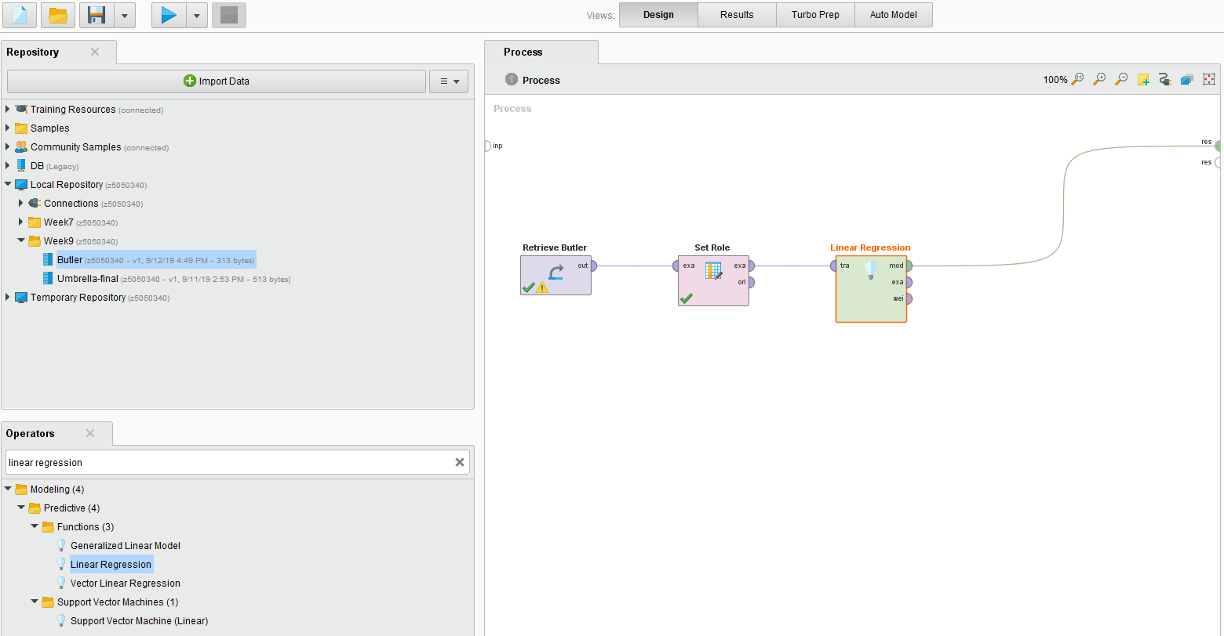
Regression modelling
4. Run
3. Connect
1. Type
2. Drag

Slide 17
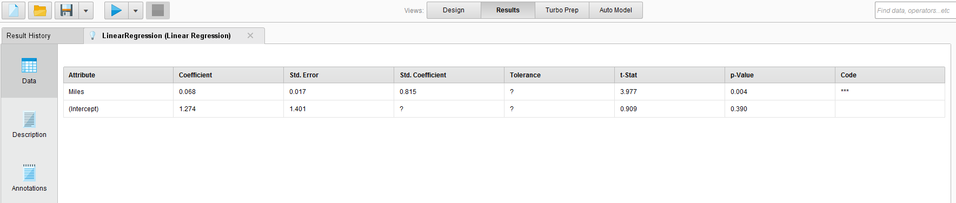
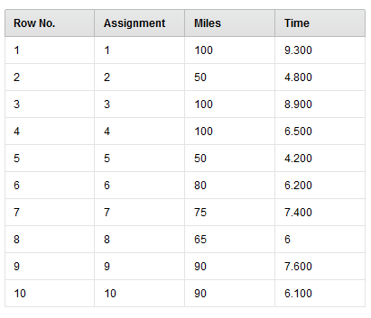
Regression modelling
The software finds that only the ‘Miles’ attribute (independent variable) has relationship with the ‘Time’ attribute (dependent variable). Therefore it only models the Linear relationship between them.

Slide 18
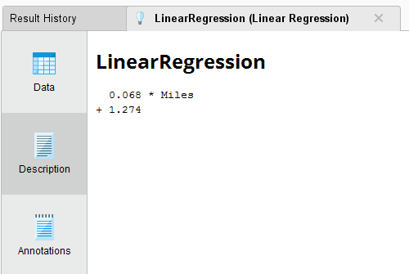
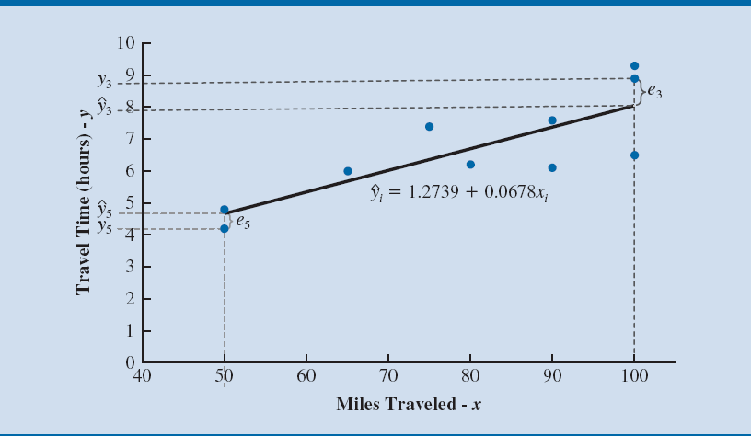
Regression modelling
Linear Regression equation generated by RapidMiner
The Linear Regression model is:
Time = 0.068 × Miles + 1.274
Same
Same results as in the Ten Butler Trucking Company example in the PPT slides.

Slide 19
Conclusion and Notes
In this presentation, we mainly focus on Regression using RapidMiner Design.
Now we can run our own datasets using the Regression model in the RapidMiner.
It is highly recommended to watch the Collaboration Recording.

